Slide 1

TABC Increased System Reliability Project
Meeting your objectives with Snapptix’s
Simple Clustering Solution -
SnappCluster
Project Contact:
William G. Beeck
732-699-7707
wgb4669@njit.edu
A New Jersey Institute of Technology Class

Slide 2
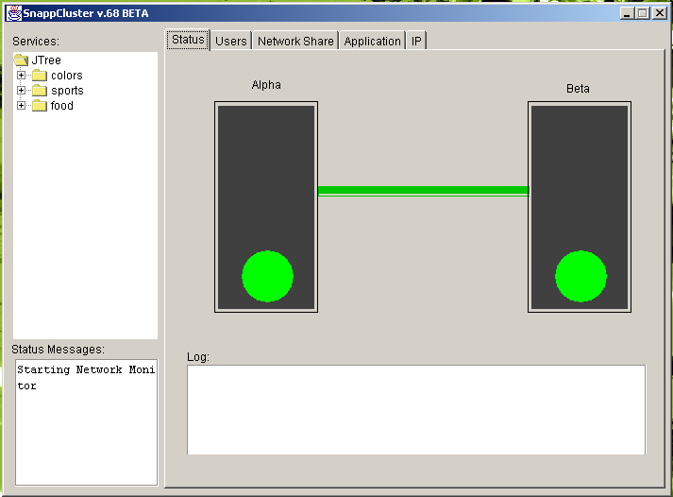
GUI – Both Servers are OK

Slide 3
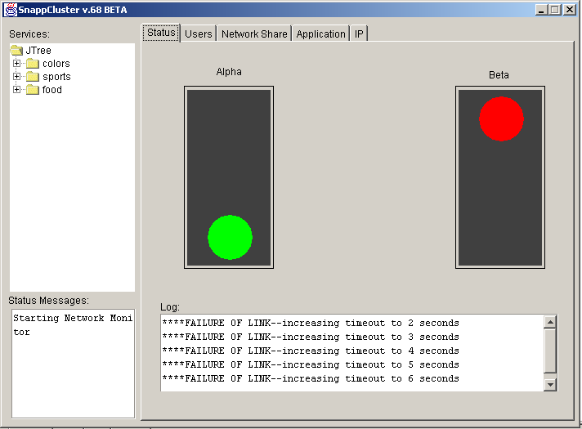
GUI – Start of Failure Detection

Slide 4
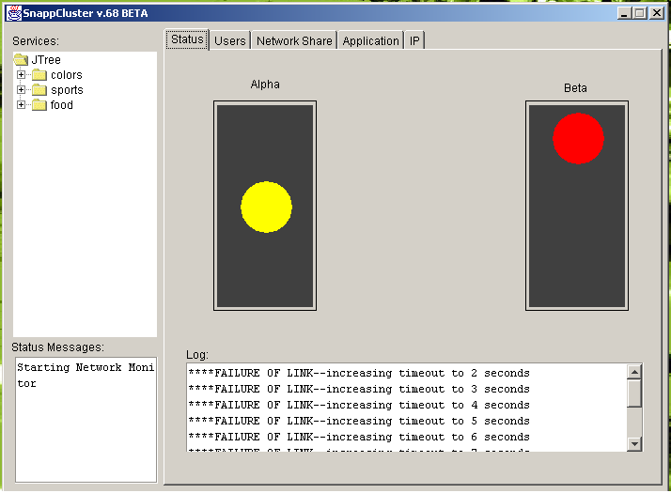
GUI – Getting Ready to Switch Servers

Slide 5
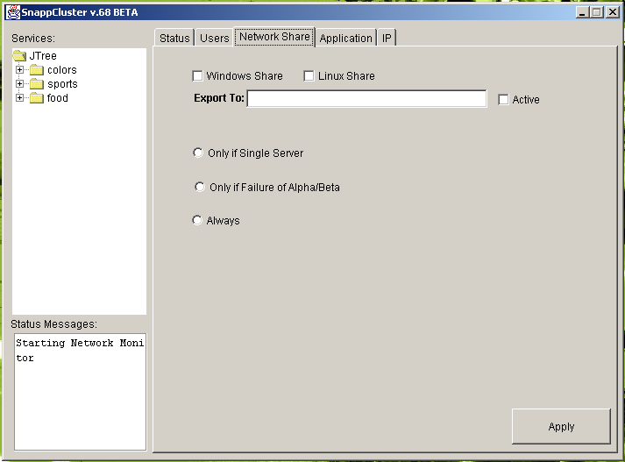
GUI – Network Share Tab

Slide 6
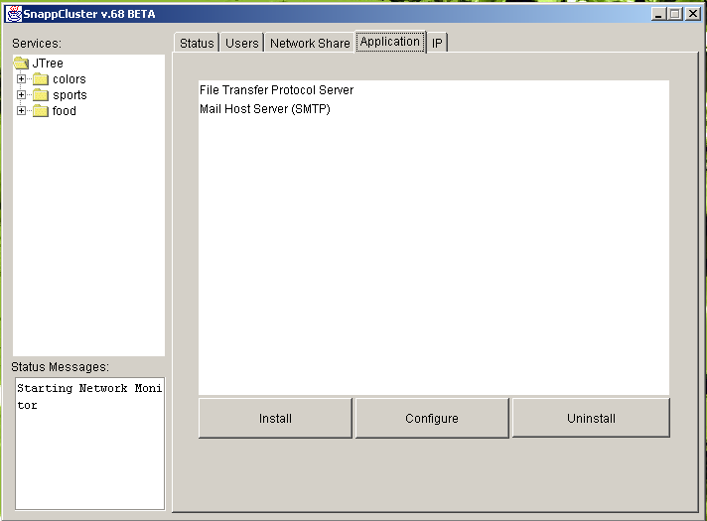
GUI – Application Tab

Slide 7
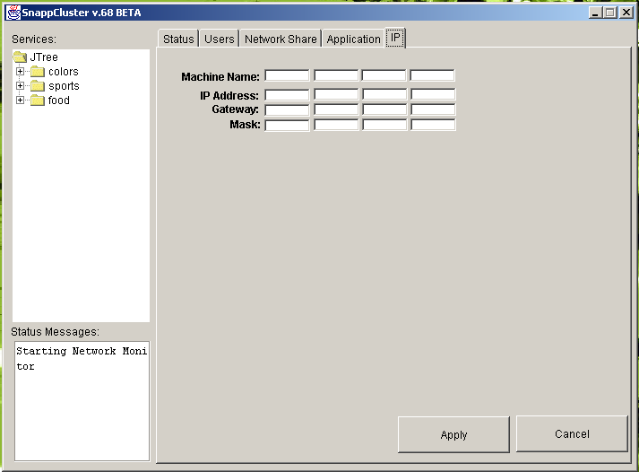
GUI – IP Tab

Slide 8
Stakeholders
Small businesses user
Small or European schools user
Workgroups in large businesses user
Municipal government user
System Administrator
Academia user
Why?
  Limited resources ($ and/or technical expertise)
  Need data redundancy
  Need mission critical services available 24x7
  Need the peace of mind that this application offers

Slide 9
Requirements Gathering Methods
Interview
Observation Method
Use Cases
Brainstorming

Slide 10
Requirements Gathering – Traditional Methods
Interview sponsor and other stakeholders
  Learnt what specific hardware they wanted
  Got a sense of their need for the product, helps in planning how we want to implement it.
  Learnt about Admin’s desire to receive an email if there were any issues with the system
Observed the AS-IS system being used
  Saw the user community at work on the current system
  Saw which manual processes need to removed to ease the system administrator

Slide 11
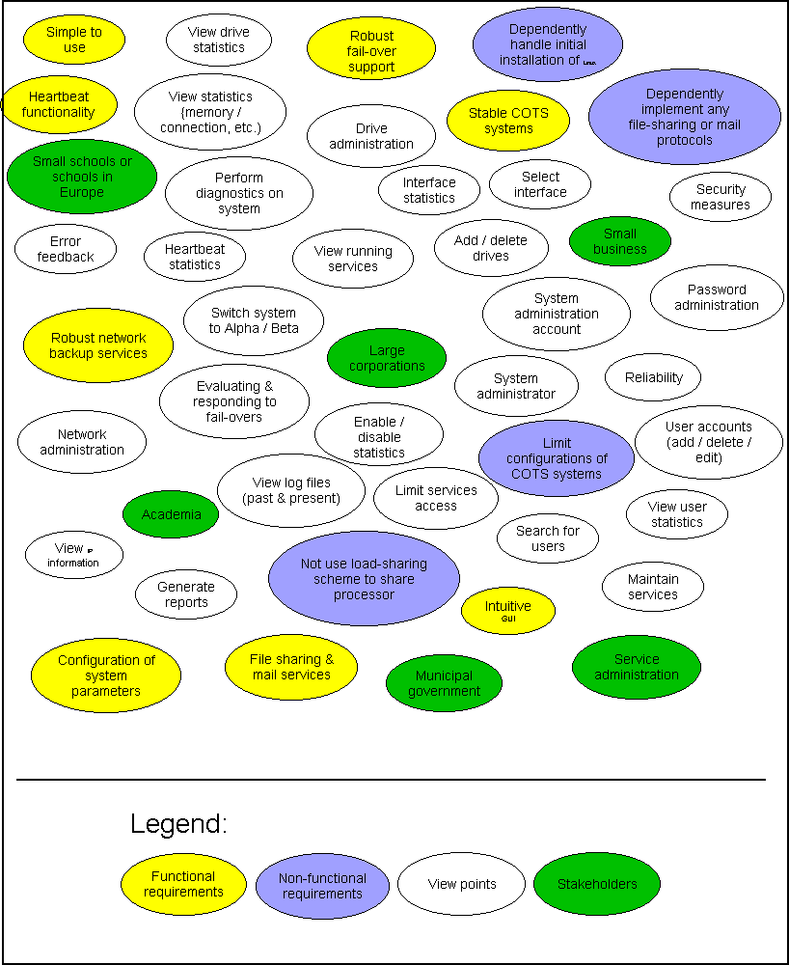
Requirements Gathering - Brainstorming

Slide 12
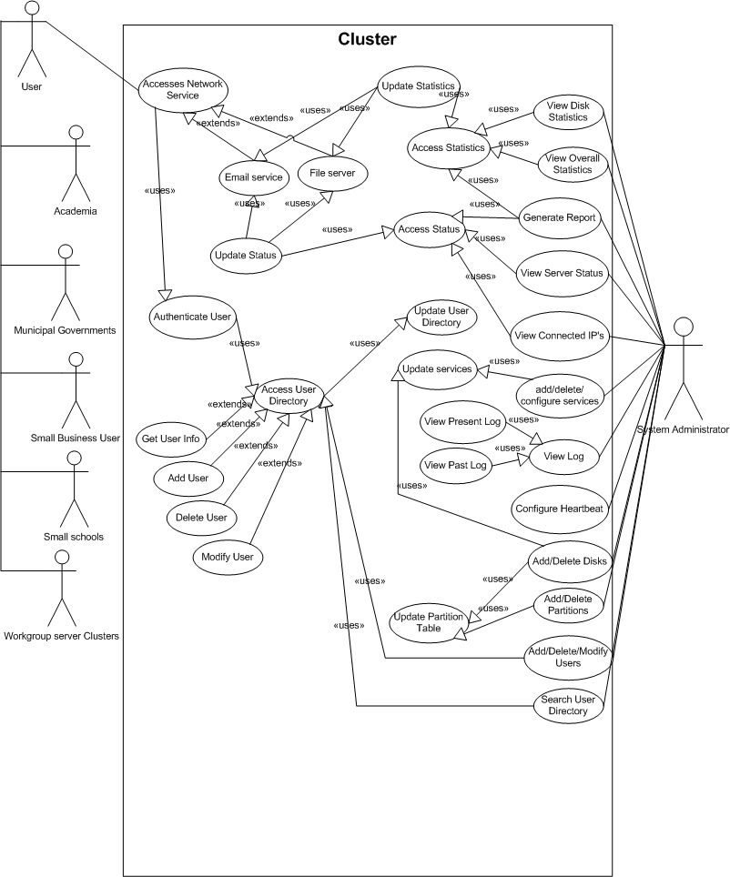
Requirements Gathering – Use Case Diagram

Slide 13
Requirements Definition
Functional Requirements
  Customized password file
  Application status displayed in real-time
  E-mail application status to administrator
  Secure communications between application modules
  “Service” tree
Non-functional Requirements
  Simple GUI
  Fail-over to Beta server within 10 seconds
  Application must run on a variety of systems
  Day-to-day administration of the application must be as non-technical as possible

Slide 14
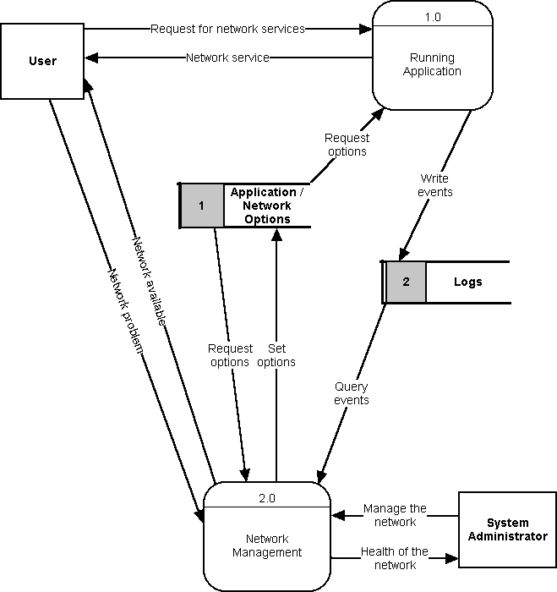
Requirements Modeling – AS-IS DFD
General Diagram

Slide 15
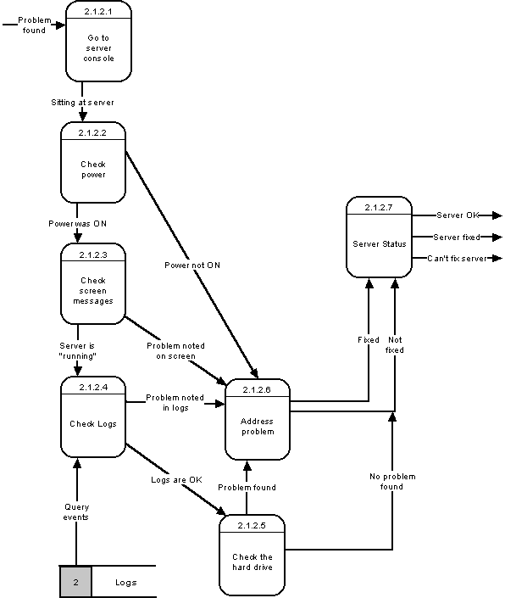
Requirements Modeling – AS-IS DFD
Server Status Process

Slide 16

Questions / Comments ??
Demo1 and Project Management Presentation March 5, 2003 – Page – <number>

